Slide 1

School of Computing
Department of Computer Science & Engineering
Batch No: 2
Project Title: Online Second Hand Book Buying & Selling Portal Software Project
Project Members: 1.Venkatesh E (VTU11341)
2.Santha Kumar D (VTU11343)
3.Gurram Rajashekaar (VTU12516)
4.Returi Shyam Bhanoday (VTU11274)
Project Supervisor: Mr Chidambaranathan C.M

Slide 2
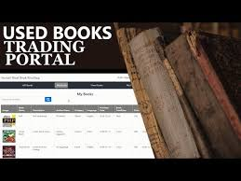
Online Second Hand Book Buying & Selling Portal Software Project

Slide 3
Abstract
Students have many course based literature text books that they have stopped reading and these books are laying on their book shelves unused. These books can be sold and the proceeds can be used to buy another book the student currently needs. These website will not only serve students but can also serve the entire population or anybody who wants to buy second hand books or wants to empty their book shelves and make financial gain from it. These books can just be simply be uploaded to the website and another student or person can have access to buy the book by just visiting the website. Students also have lesser incomes compared to the rest of the working population. Hence any reasonable resource for getting income is always welcomed. All these will be achieved by creating a user friendly complete online shopping system for buying and selling second hand books. Customers can access the bookstore web site through the World Wide Web. Customers will be able to search the database to find the books they want, check the availability, and place the order to buy the book using their credit cards.

Slide 4
Languages Used:-
Front end:-
HTML
Java
CSS
Back end:-
My SQL
PHP

Slide 5
Basic Concepts of This Project
The motivation to create this project has many sources
Interest to develop a good user friendly website with many online transactions using a Database.
To increase our knowledge horizon in technologies like PHP, SQL, CSS, and HTML.
To gain good experience in web before joining in a full time job.
To gain expertise using Data Grid, Data Set, Data Table, Data Adapter and Data Readers

Slide 6
Analysis And Identifying The Problem
The present system includes a physical showcase where people search for their required book and purchase them afterwards. This procedure necessitates every feature like book, buyer, seller and price to be actually present at the sale. We aim to develop a website as a front end of a bookstore portal to eradicate this physical presence at sale. As the web based business get to be distinctly widespread, the Imperial Book Store is considering about extending its support of the services through the Internet. This project is to develop a Web application (called Imperial Web Book Store or IWBS) to assist the Imperial book shop with operating its business through the internet. The IWBS system supports online book selling and shopping. It additionally permits clients to offer their utilized books to the book shop by means of the Internet.

Slide 7
Literature Review
Electronic Commerce applications support the interaction between different parties participating in a commerce transaction via the network, as well as the management of the data involved in the process .
The increasing importance of e-commerce is apparent in the study conducted by researchers at the GVU Center at the Georgia Institute of Technology.
In their summary of the findings from the eighth survey, the researchers report that "e-commerce is taking off both in terms of the number of users shopping as well as the total amount people are spending via Internet based transactions".

Slide 8
Literature Review
Several articles have detailed the methods some libraries have developed to increase profits from the sales of surplus gift and withdrawn materials.
The impetus to sell the finer quality donated books through auctions is well documented, as is the subject of opening bookstores in lieu of traditional library book sales;
articles dealing with libraries selling materials online are harder to find.
Although selling used books on the Web has been occurring for several years, libraries using the Internet as a means to dispose of and profit from selling withdrawn or surplus gifts is a relatively recent development.

Slide 9
Literature Review
A good e-commerce site should present the following factors to the customers for better usability:
• Knowing when an item was saved or not saved in the shopping cart.
• Returning to different parts of the site after adding an item to the shopping cart.
• Easy scanning and selecting items in a list.
• Effective categorical organization of products.
• Simple navigation from home page to information and order links for specific products.
• Obvious shopping links or buttons.
• Minimal and effective security notifications or messages.
• Consistent layout of product information.

Slide 10
Data Collection
Data collected for Online Second Hand Book Store Portal is done by a main admin who has the every details about the users.
Every books uploaded by the users are get into the database.
Books which are in the database is segregated according to the categories of different types like as author, tittle etc….
Like wise users in different end upload the books which is to be sell in the portal.
Every book stored in database by the categories can be viewed to the users at every places so that they can access the books of all categories.

Slide 11
Design And Methodology
This project designs an online bookstore provides a web-based interface. It is the graphical user interface.
It have a form for user to input query information to search the database. The users interface then pass the input to the control function, which implemented in Java.
The control function is designed to process the input from the users interface, generate the searching query and then gets data from the database and returns to the users interface.
The control functions also have bridges to search some external real online bookstores. It can generate the query based on the user input and pass them to the commercial bookstore.
The bridge can also handle the response from the commercial bookstore and parse the useful information and display to the user in HTML forms.

Slide 12
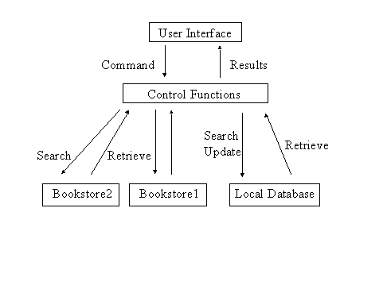
Logic Diagram:-

Slide 13
Code Implementation
I. Database overview:
The online bookstore database sit on the Oracle is made of 4 tables.
Fbooks:
Define the inventory of books. It has the fields of: ISBN(primary key), Title, Author, ImageType, Price, Publisher and NumberInstock.
Fcutomers:
It saves all the information of the customers. It has the fields of: CusomterID(primary key), User, Passwd, Fname, Lname, Address, City, State, ZipCode, Phone, Fax and Email.
Forders:
It has the order information. The fields are: OrderID (primary key), CustomerID, TotalPrice, OrderDate, CardName, CreditCard, CreditType and ExpDate.
Forderdetail:
It saves the information of every books on a multiple book order. The fields are: OrderID, ISBN, Quantity and ShipDate. Primary key is the combination of OrderID and ISBN.

Slide 14
II. Java class file overview:-
This project consists of a total of 13 java files.
BookDetails.java
Define the object for an individual book. Every book has ISBN number, the Title and Price.
ShoppingCartItem.java
Every shoppingCartItem holds an object, which is a book and the quantity of the book.
ShoppingCart.java
ShoppingCart is implemented as a hashtable which can hold a book in ShoppingCartItem and number of different books in the hashtable. Add method is to add one ShoppingCartItem into the hashtable. Remove methold remove one from the hashtable.
Cashier.java
Cashier class hold an object of shoppingCart and has the method to calculate the total price of all books in the shoppingCart plus the tax(if any).
BookpoolSearch.java
This class worked as a bridge between the client's query and the online bookseller Bookpool.com. This can handle cilent's search by title and by author. After getting client input either by title or author, a query in the format of URL string is generated and sent to bookpool.com using java's standard URL class. Bookpool.com will respond to this query by returning a long string of html source code containing books of their database matching the query provided by the client.

Slide 15
FatbrainSearch.java
Another bridge class works similar to the BookpoolSearch.java. It will connect to the online bookseller Fabrain.com. This can handle the user search query by title, author, subject and publisher.
BookSearch.java
This class handle client's query to search the local Oracle database by Title, Author, ISBN and Publisher using Java JDBC. And using Java Servlet to generate html source code to display on client's screen. ShoppingCart was implemented by the Servlet Session Tracking technology. It takes the input from the bookstore main page, generates the searching query, searches the database and pastes the book found to user's screen. User can add any displayed books into the shopping cart by pressing the 'add to cart' icon.
ISBNSearch.java
This class handles client's query to search by ISBN and display detailed book information for the user. This include the full title of the book, the image of the book and also the author, publisher and numbers in stock. The image is handle in a simple way. All the image files are saved in the server's /images directory.
ShowCard.java
This class will display all the books user add to his shopping cart. Through the Servlet Session Tracking API, session was found by checking the session ID. Books information was extracted from the hashtable of the shoppingCart object. Html code was generated and send to user's screen by the Servlet doGet method.

Slide 16
Login.java
Once the user decide to checkout to buy books, user are asked to input his registration information. If the user has account on the bookstore before, he just need to input his userID and password. This class collects the userID and password and then search to see if the info was valid against the Oracle database using Java JDBC. If the info was matched to the record, user was redirect to continue checkout. Otherwise, user was asked to input some personal info to create an account.
SignIn.java
This class is to create a new account to the first time customer, the information will be inserted into the Fcustomer table by using Java JDBC.
CheckOut.java
This class first displays all the contents in the shopping cart, then prompt user to input his credit card information which include the name on card, credit card number, the type of credit card and expiration date. If either of them is empty, let user go back to input again.
SubmitOrder.java
This class is called once user has input all his credit card information. An order is generated in the Forders table by assigning a new orderID. Total price and credit card information will be inserted to the table. Also in Forderdetail table, every book in the shopping cart will be an item on the table. Finally, numberinstock value in the Fbooks table has to be updated since the user already buys the book.

Slide 17
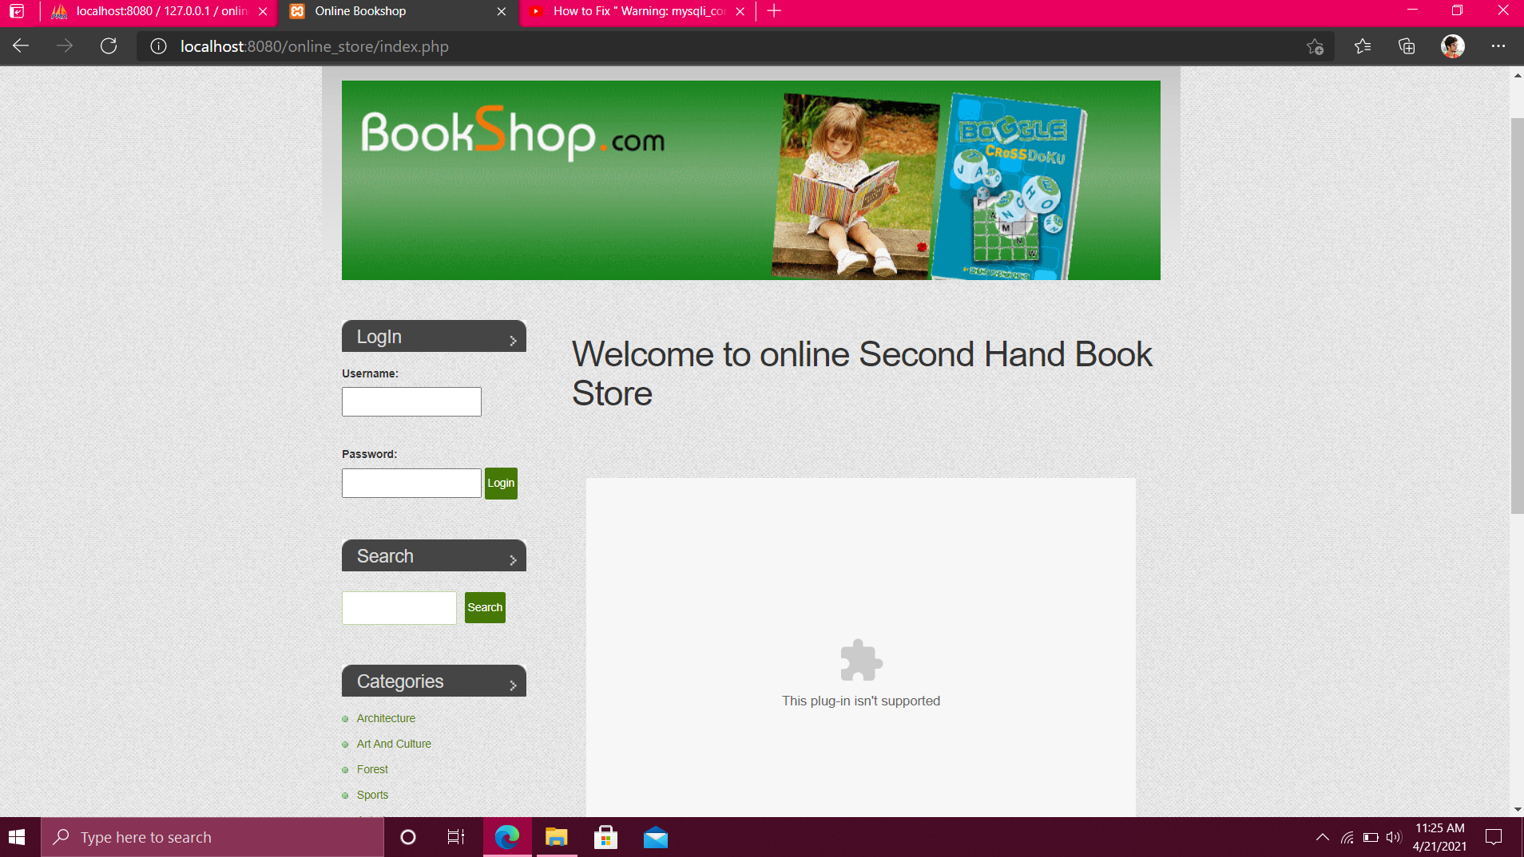
Front End: Welcome Page

Slide 18
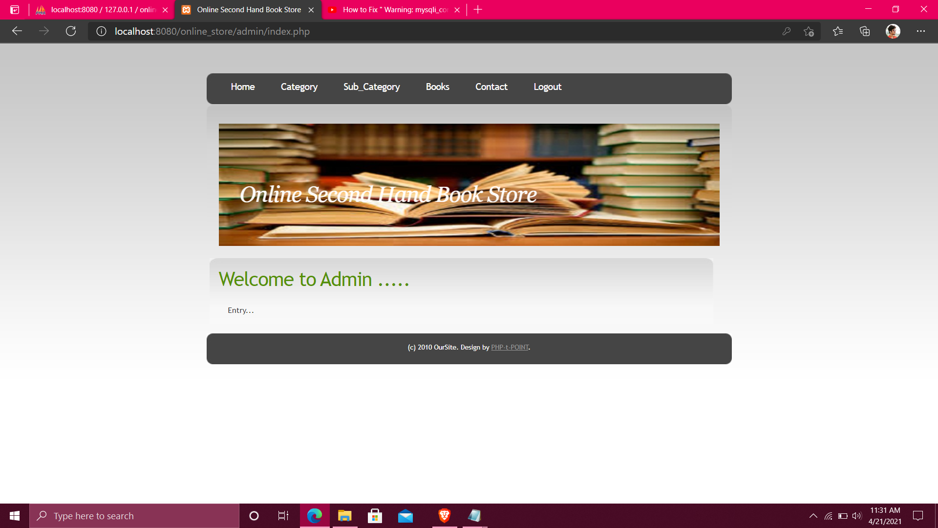
Front End: Admin Page

Slide 19
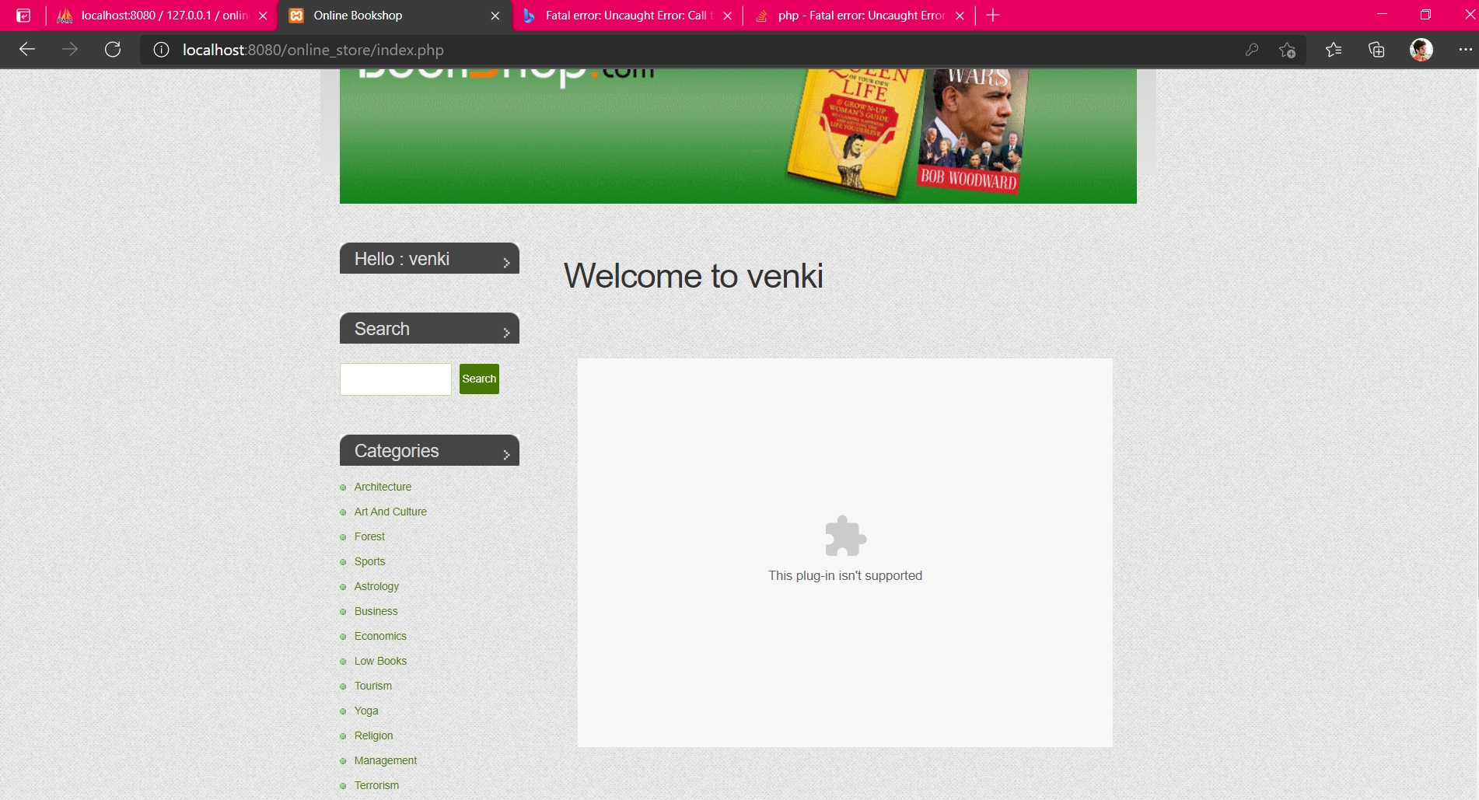
Front End : User Page

Slide 20
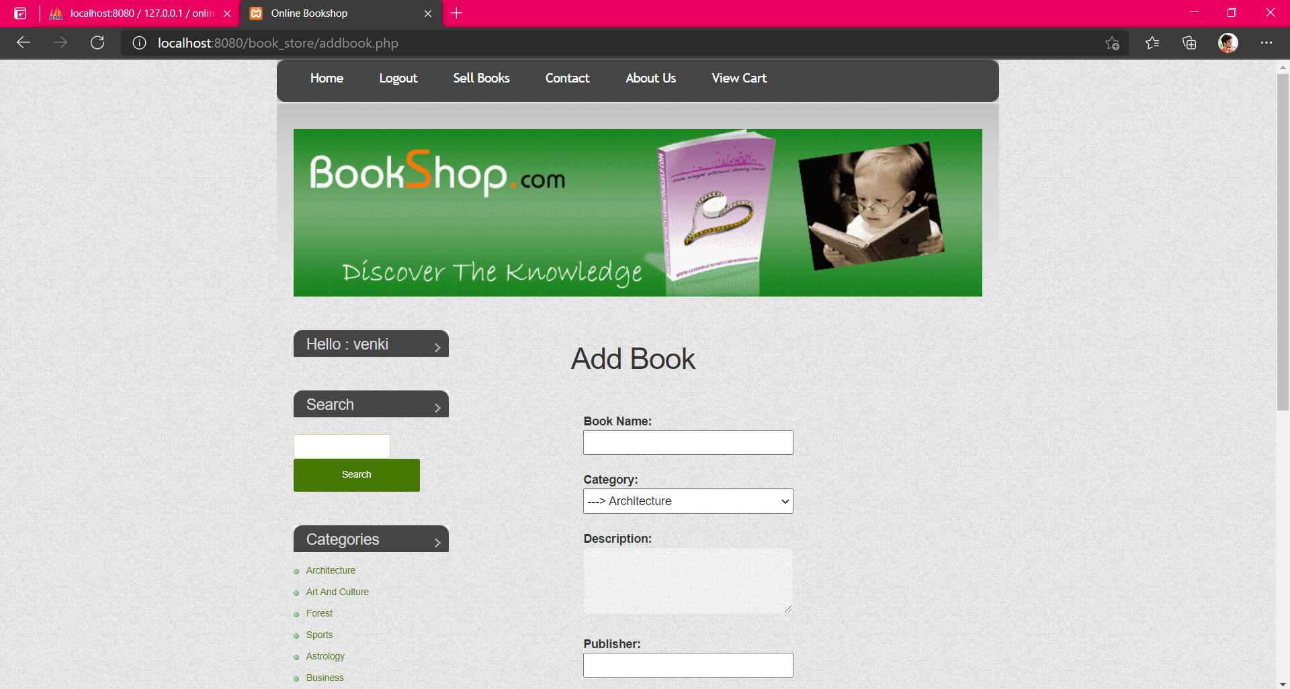
Front End : User’s Selling Portal

Slide 21
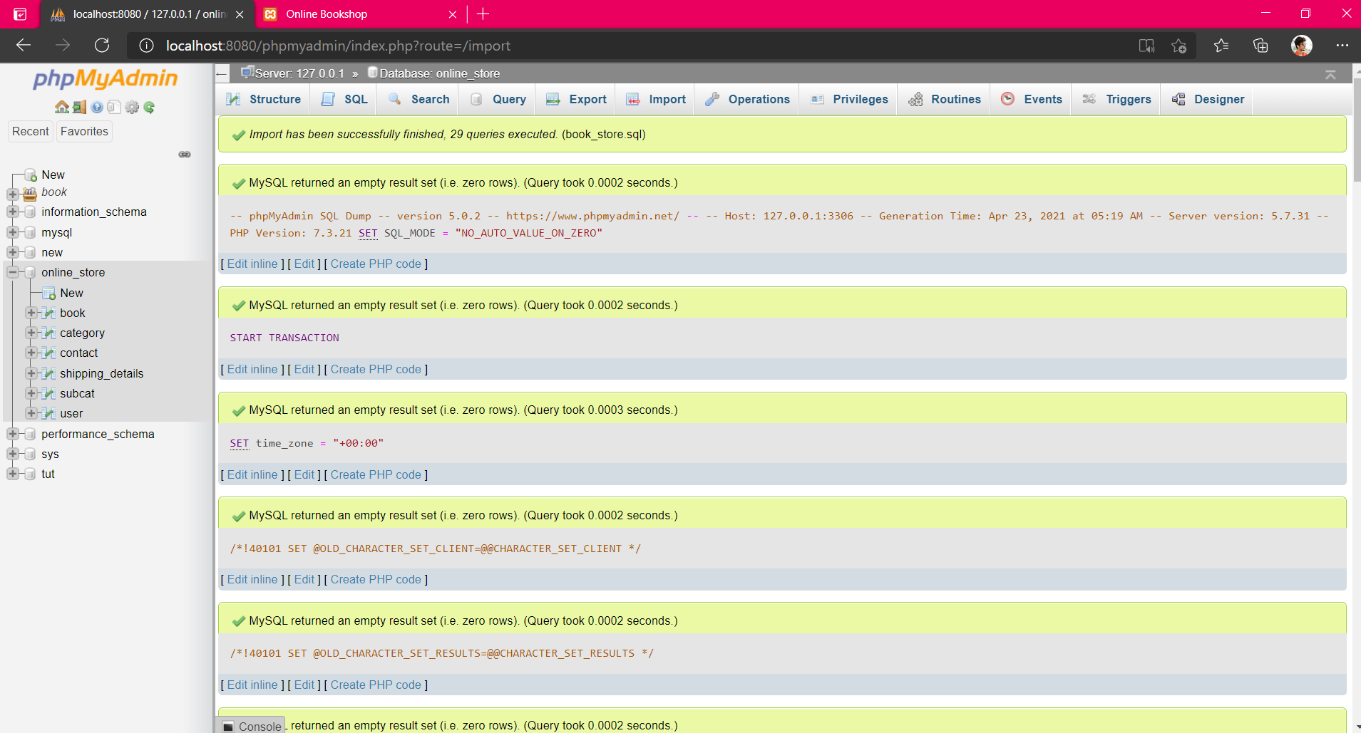
Back End: Import Database

Slide 22
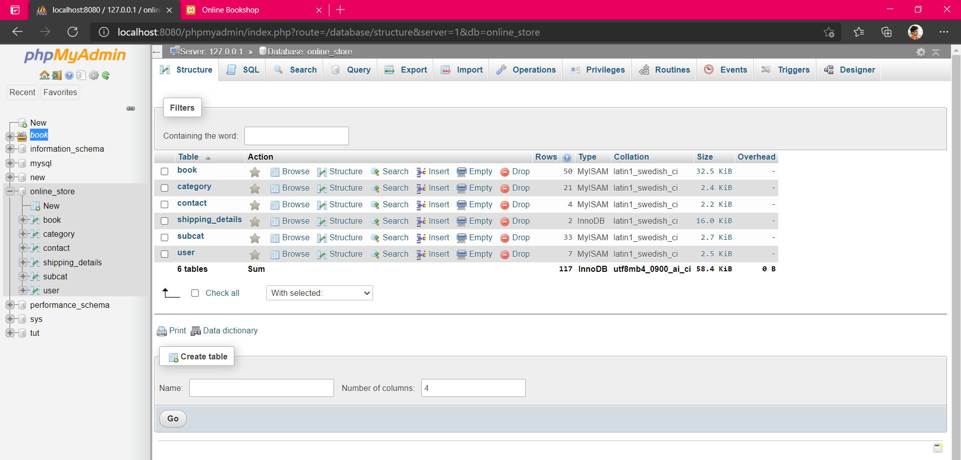
Back End : Structure

Slide 23
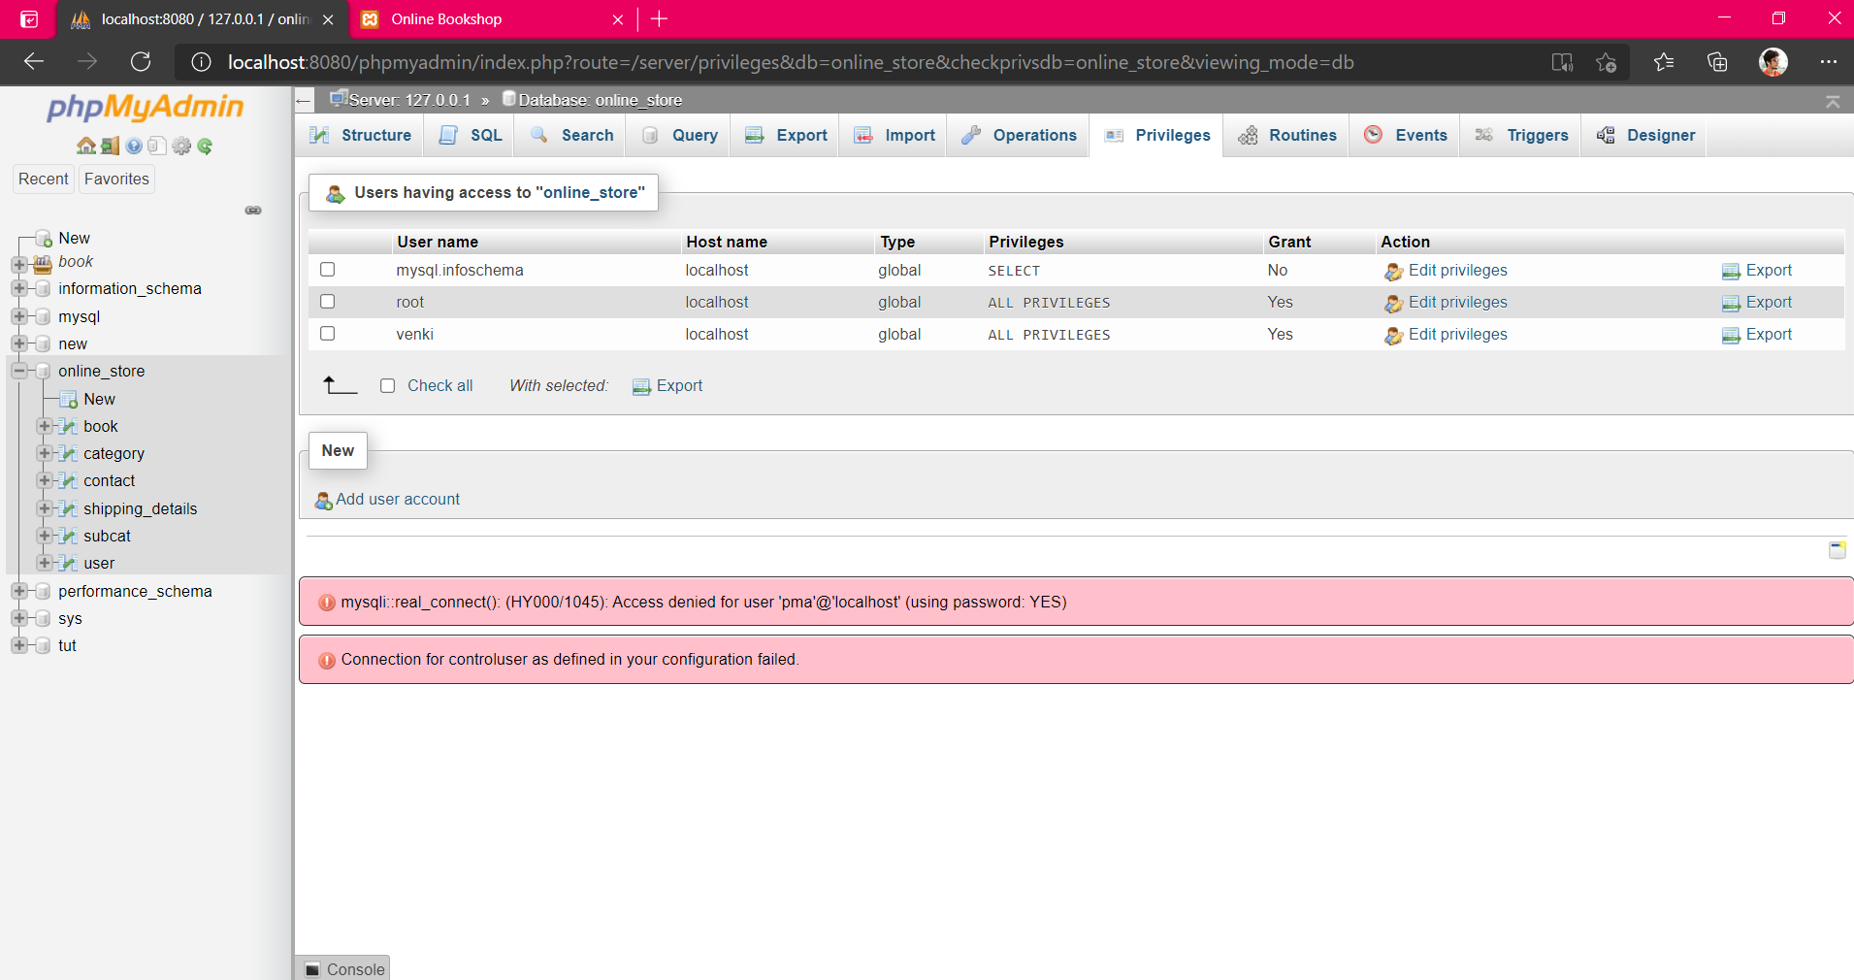
Back End : Privilleges

Slide 24
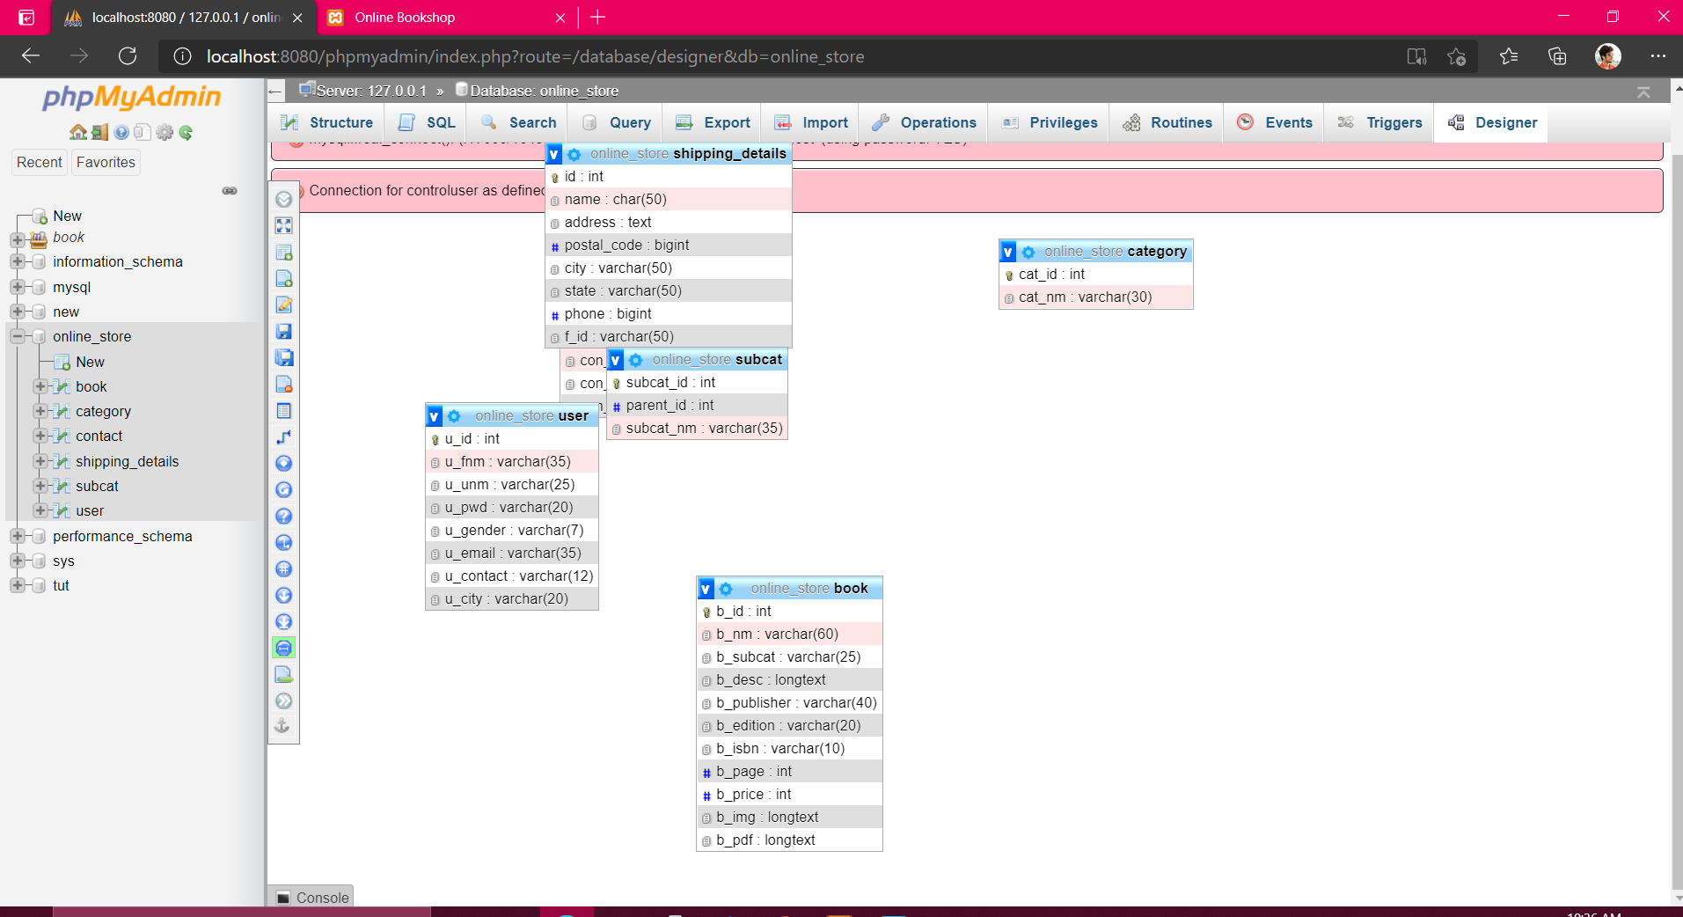
Back End : DML Diagram

Slide 25
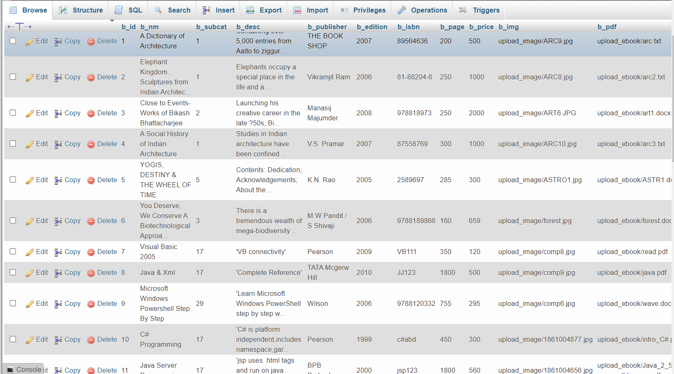
Query: select*from books

Slide 26
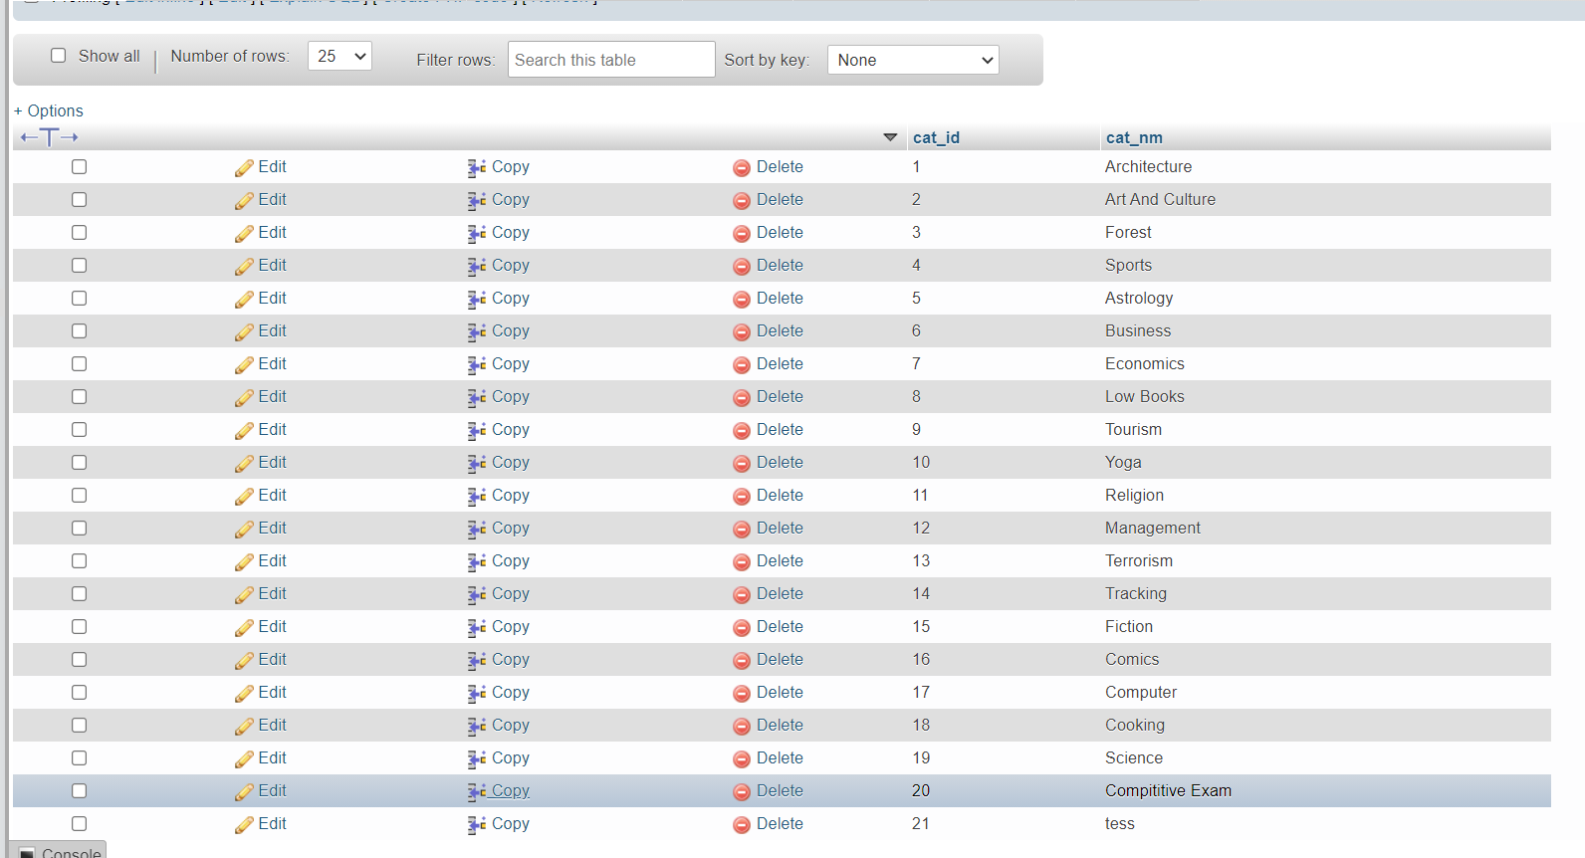
Query: Select*from category

Slide 27
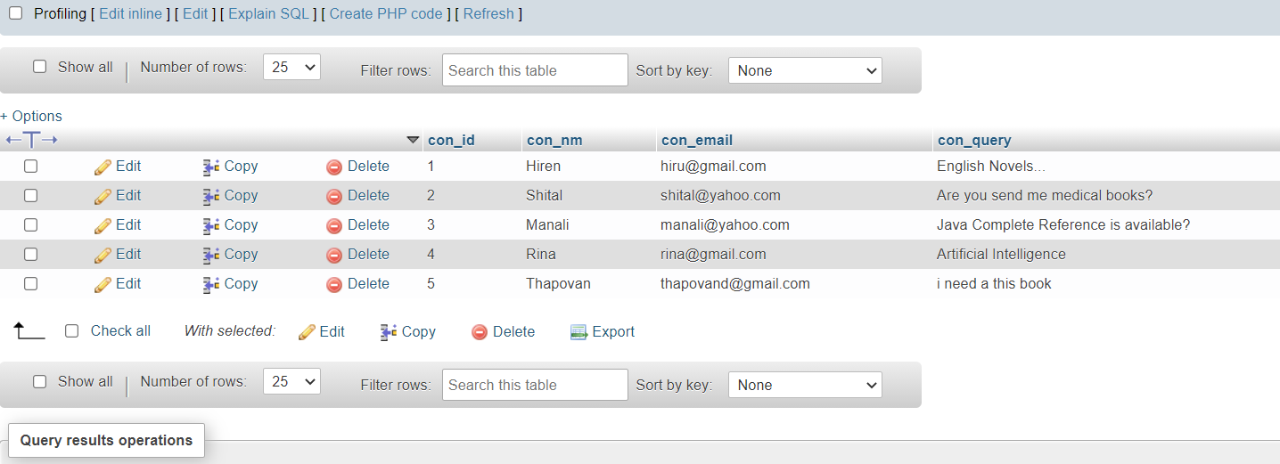
Query : select *from contact

Slide 28
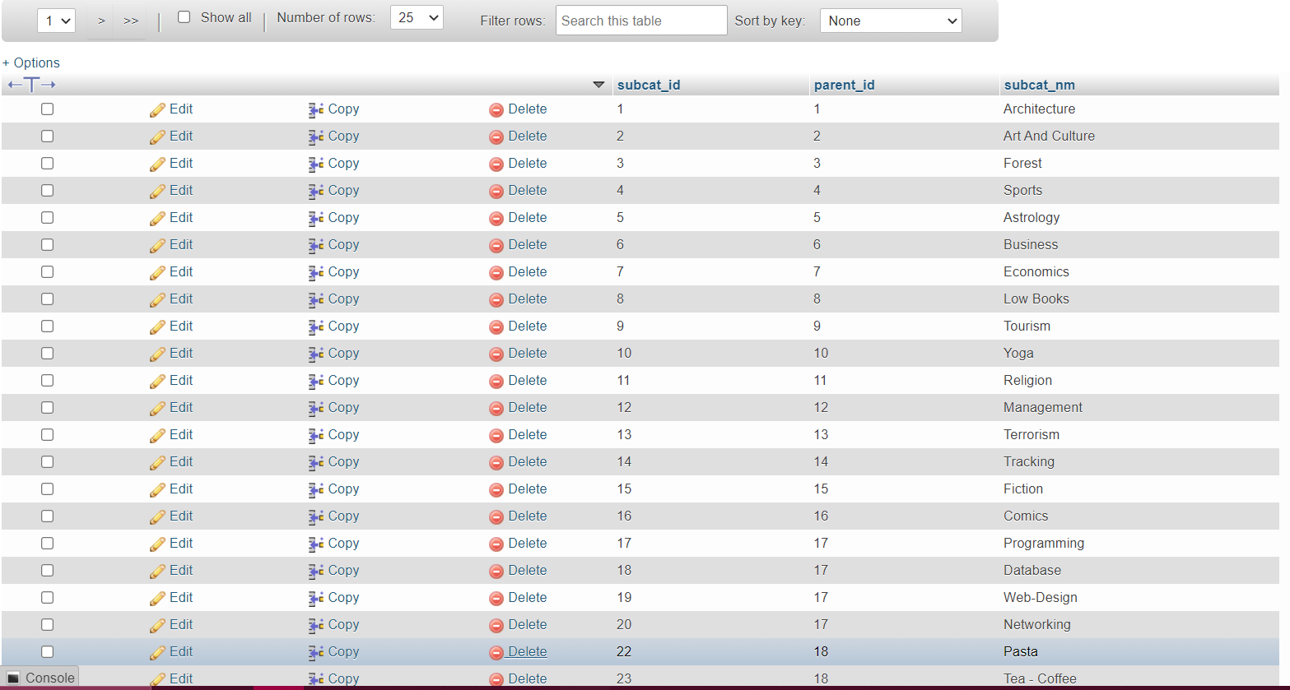
Query : select *from sub_category

Slide 29
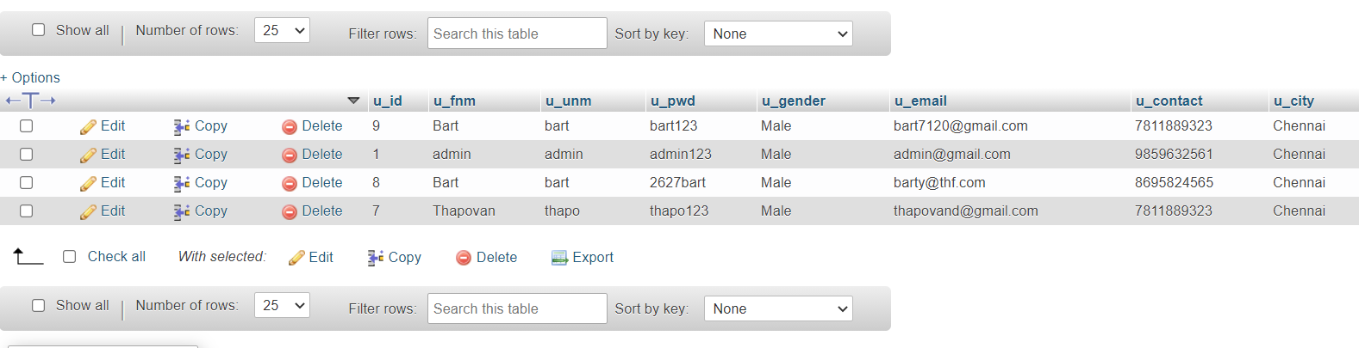
Query : select *from users

Slide 30
THANK YOU

